Slide 1
Who is BC Housing?
BC Housing works in partnership with the private and non-profit sectors, provincial health authorities and ministries, other levels of government and community groups to develop a range of housing options, to address critical gaps across the housing continuum, from emergency shelter and rent assistance in the private market to affordable home ownership.
WHO WE SERVE
Individuals who are homeless
Individuals with disabilities
Indigenous individuals and families
Women and children at risk of violence
Low-income seniors and families
Buyers of new homes

Slide 2
What does BC Housing do?
Develops a range of housing options
Works with about 800 housing providers
Helps more than 110,000 households in communities across British Columbia
Licenses residential builders
Administer owner builder authorizations
Carries out research and education that benefits the residential construction industry and consumers

Slide 3
Affordable Housing Solutions
Building New Housing for Vulnerable People
Creating More Affordable Rental and Home Ownership
Protecting Existing Stock

Slide 5
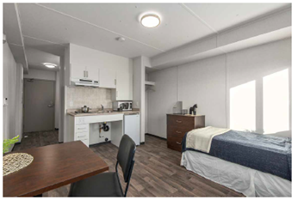
The Housing Continuum: Housing with Support Services
Women’s Transition Housing Fund
Who: Women and children at risk of violence and/or have experienced violence
Four Housing Models: Safe Homes, transition house, second stage housing and long-term rental housing
Funding Partners: Not-profit service providers interested in developing and operating new rental housing
Sites: BC Housing or non-profit can provide the land.
Supportive Housing Fund
Who: Adults over 19 who are homeless or at risk of homelessness
Housing Model: Affordable rental housing with onsite support services
Funding Partners: Not-profit providers that are interested providing property management and support services
Sites: BC Housing or non-profit can provide the land.

Slide 6
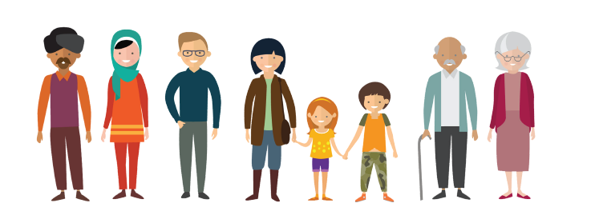
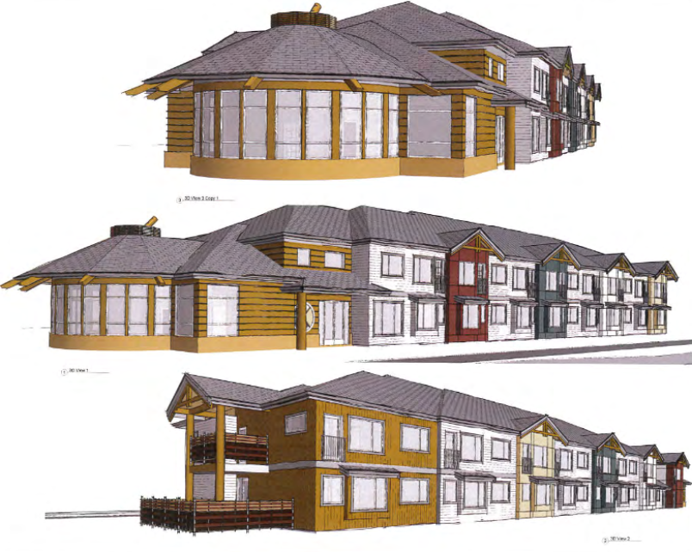
The Housing Continuum: Social Housing
Community Housing Fund
Who: Families and seniors capable of living independently
Model: Affordable rental housing
30% affordable market
50% rent geared to income
20% deep subsidy
Funding Partners: Not-profit service providers OR for-profits that partner with non-profit societies interested in developing and operating new rental units
Sites: Non-profits or municipalities provides the land.
Indigenous Housing Fund
Who: Indigenous families, seniors, individuals or persons with a disability
Housing Model: Affordable rental housing
Funding Partners: Indigenous not-profit housing providers, First Nations, Metis Nation BC, non-profits, and developers who want to partner with Indigenous organizations and First Nations
Sites: Non-profits or nations provide the land.

Slide 7
The Housing Continuum: Rent Assistance in the Private Market
Rental Assistance Program (RAP)
The Rental Assistance Program provides eligible low-income, working families with cash assistance to help with their monthly rent payments.
156 families supported in Maple Ridge
Shelter Aid for Elderly Renters (SAFER)
Helps make rents affordable for BC seniors with low incomes. SAFER provides monthly cash payments to subsidize rents for eligible BC residents who are age 60 or over and who pay rent for their homes.
415 senior households supported in Maple Ridge
Visit: www.bchousing.org/housing-assistance/rental-assistance for more information

Slide 8
The Housing Continuum: The HousingHub Affordable Rental Housing and Homeownership for Middle-Income Earners
BC Housing
Local Housing Groups
Indigenous Groups
Faith-Based Groups
Charities
Community Land Trust
Financial Institutions
Developers
Local Government

Slide 9
How communities can get involved in planning for new housing
Citizens
Get involved with Municipal Committees
Support a local non-profit providing housing
Attend public hearing to support the creation of housing
Non-Profits
Form a Housing Task Force
Start planning to respond to BC Housing public Request for Proposals under their funding programs
Meet with BC Housing and City staff to discuss your ideas
Municipality
Conduct a Housing Needs Assessment
Offer land at nominal value for the creation of affordable housing
Waive fees to support affordability
Expedite processes to create housing more quickly
Work with senior levels of government to meet your housing needs

Slide 10
Provincial Government
Municipality
Community
Health Authority
Housing & shelter operators
Service Providers
Impacted Individuals
It takes a community to address​ homelessness

