Slide 1

FORWARD TOGETHER COWICHAN
Our Shared Vision for
Housing, Health & Wellness
2026

Slide 2
THE COWICHAN REGION
Our community is facing a crisis.
Previous success in the Cowichan region has been largely due to the way in which we work together, our regional approach to resolve complex social issues.
Cowichan region local governments and Indigenous leaders are aligned across civic jurisdictions and mandates and united in their approach to clear and coherent goals.
Members of the Cowichan Coalition to End Homelessness have collaborated on a
3-phase comprehensive response to this complex crisis in our community.

Slide 3

























Built on Partnerships and Working Together
Cowichan Neighbourhood House

Slide 4
Our Current Data
Through local data collection efforts in 2025 (Front Line Provider and annual Point in Time counts) we are better able to understand the context of homelessness in our region including:
79 Youth (under age 27) , 32 of whom were sleeping rough
The need for complex housing for 9 youth who are unhoused or precariously housed for whom current housing options are not sufficient
Approximately 20 people living in vehicles
89 people over the age of 55 who are unhoused or precariously housed

Slide 5
Our Current Data –
Recommendations from Front Line Provider Count
1. Establish Complex Care in Duncan-Cowichan.
Build and operate culturally-safe complex care housing facilities - at least 39 adult and 9 youth beds
Enhance and integrate frontline complex care outreach into existing services for the 165 people who
experience barriers to programming
2. Use Frontline Provider Count Numbers for Funding & Resource Decisions
Numbers from the Cowichan Frontline Provider Count should inform decisions on funding, resource allocation, and prioritization
3. Indigenous-Led Supportive Housing
26 Indigenous youth-focused and youth transitional units
70 Indigenous-Led, Culturally-Grounded Supportive Housing adult units

Slide 6
4. Enhance Homecare Supports and Adopt a Palliative Approach to Care
Provide homecare supports in shelters, supportive and transitional housing
Acknowledge increased need to address staff-client ratios and operational needs to improve health outcomes for those living with chronic conditions and needing palliative care support
5. Youth Subsidies for Safe and Appropriate Housing
Provide subsidies for the 10 youth who face no known barriers to housing other than lack of
safe and affordable housing options
6. Include more 1-Bedroom and 2-Bedroom Units in New Housing Facilities
New housing facilities must include more 1-Bedroom and 2-Bedroom for people who are
seeking housing with their partner or caregiver

Slide 7
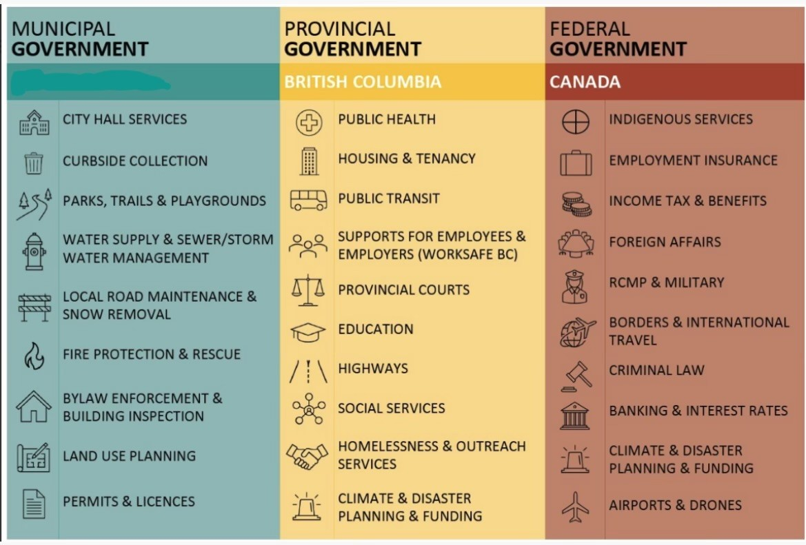
Our Shared Vision:
Complex social issues cannot be resolved by communities alone and require all levels of government working collaboratively

Slide 8
Our Shared Vision:
A 3-Phase comprehensive plan
requiring all levels of government to work collaboratively,
with Investments in:
Land
Buildings/Infrastructure
Operations

Slide 9
Phase One - Prevention/Diversion
Focus on upstream actions that reduce new entries into homelessness
Increase Shelter Capacity
Eliminate Poverty
Financial Stabilization
Palliative Approach to Care
Complex Care Supports
Provide the right mix of services in a coordinated, flexible, and person-centered way to allow individuals with complex needs to maintain stability, receive appropriate care, and remain in their homes for as long as possible.
Reduce staff-client ratios and engage wrap around, in-reach services as appropriate to individual needs.
Support employee retention through training and wellness supports
Increase Permanent Shelter Capacity across the region
Ensure Extreme Weather Sheltering for cold/heat events.
Establish a coordinated and community wide prevention and diversion program that addresses landlord retention, eviction prevention and rapid rehousing initiatives
Expand homecare supports to include shelters, supportive and transitional housing
Reduce staff-client ratios and address operational needs to improve health outcomes for those living with chronic conditions and would benefit from a palliative approach to care
Support Employee Retention through training and wellness supports
Investments in housing loss prevention measures:
Subsidies for non chronic youth
Rent subsidies
Advocacy at Federal level for Guaranteed Basic Income

Slide 10
Phase Two – Intervention & Support
Targeted investments, stabilization and guidance for those already in stream
Village Style Indigenous-led Supportive Housing
RV Parking
Seniors Housing
Acquisition or lease of 2x sites for RV parking
Acquisition or lease of 5x sites for Village-style projects including: Sober living, Youth specific, Indigenous-led, Low barrier x2
Head leasing of four
5-bedroom homes to allow for communal living and an alternative to isolated rental market options
Site servicing
Supportive Zoning
Site Servicing
Supportive Zoning
Peer Support Options
Support light renovations to adapt spaced to improve in home accessibility and safety for seniors
Option for onsite, skills employees to provide daily support or coordinated daily outreach for light touch supports.
Ongoing site maintenance
Skilled employees to provide trauma informed, culturally sensitive daily supports
Ongoing site maintenance
Skilled employees to provide trauma informed, culturally sensitive daily supports
Ongoing site maintenance

Slide 11
Phase Three - Stabilization and Integration
Ensure long term stability and sustainability
Supported Housing
Complex Care
Affordable Housing
Purchase of 2 development sites for supportive housing projects
Purchase of development sites or existing buildings to offer transitional housing
Investments in affordable housing options for those whose only barrier to housing is financial
Construction of 2 x 50-70
unit buildings
Renovation of existing space
to meet specific needs of those leaving mental health or addictions treatment
Skilled employees to provide trauma informed, culturally grounded daily supports
Site and building maintenance
Skilled employees to deliver trauma informed, culturally grounded treatment and daily supports

Slide 12
YOUR SUPPORT
Local leadership can support this regional plan through:
*Endorsement - together our voice is stronger
*Joint Advocacy - seeking provincial and federal
investments to fund this plan
*Contribution - land/infrastructure,
- supportive zoning and bylaws

Slide 13
Huy ch q’u
Thank you

