Slide 1
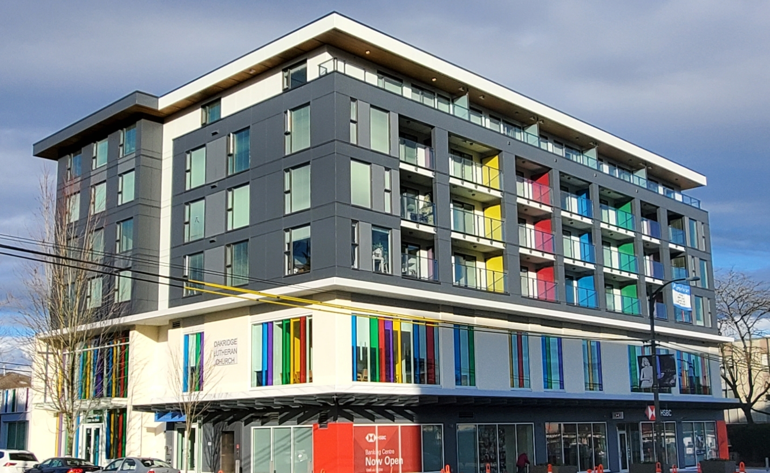
Vancity
Affordable
Community
Housing
Program
Greater Vancouver Community Assistance Foundation
Notes:
The Affordable Housing Program

Slide 2




Who we are.
A transformed economy that protects the earth and guarantees equity for all.
Charitable Foundation affiliated with Vancity Credit Union. Operates and manages the Vancity Affordable Housing Program and Accelerator Fund
Vancity Credit Union: Investor partner in the Affordable Housing Program and Accelerator Fund, and contributes Community Business Real Estate Services & Expertise and financing
2
Notes:
We use our assets to help achieve our vision of a transformed economy that protects the earth and guarantees equity for all.
VCF is charitable foundation since 1989 launched by Vancity Credit Union. For over three decades Vancity and VCF have worked closely to develop and delivery programs and projects to advance wellbeing for community and our members that advance economic inclusion and environmental sustainability. Current focus areas include affordable housing, homelessness and social and economic innovation through projects like BC Rent Bank, Reaching Home, Living Wage for Families, Affordable Community Housing Program + Accelerator Fund and 312 Main. We are also have over 100 donor advised fund ($60 million in capital) managed, some of which is invested in impact funds and projects, like the accelerator fund
In 2011, Vancity and VCF worked together to launch the pre-development loan fund which is now called the Vancity Affordable Housing Accelerator Fund which is held at the Greater Vancouver Community Assistance Foundation.
As of 2022, the full management and operations of the fund has moved over to the Foundation, and Vancity will continue to be an investor partner in the Fund.

Slide 3
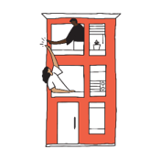
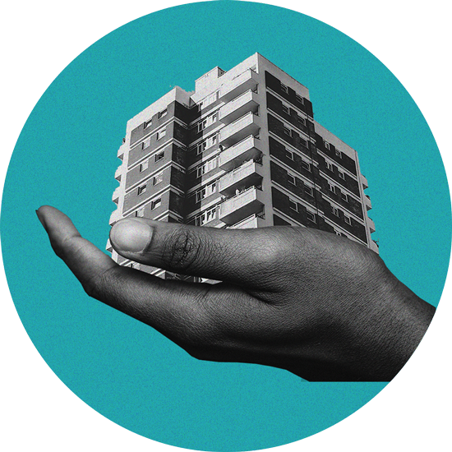
We have a housing
crisis.
More
non-profit community housing is
a solution.
3
Notes:
I probably don’t need to tell anyone in this room about the challenges people and families are facing in finding secure and affordable rental housing. We see it everyday in our communities.
It's estimated that 43,000 new homes are needed annually over the next 5 years in BC to address the supply gap (UBC)
Opportunity:
We have a vibrant and committed community housing sector – the non-profits, co-operative housing and Indigenous housing organizations (folks in the room) that have the potential to help solve this problem and they are rising to the challenge - by developing existing sites, acquiring land or private rental buildings and partnering with municipalities to get more housing built.
And
Yet, we know the sector often lacks the early-funding required to advance their projects, which can slow down and prevent the development of much needed housing.
That’s where we come in to help solve this problem by investing in the sector so they can achieve their affordable housing goals.

Slide 4


Program Goals.
To grow the supply of community-owned affordable rental housing for people with low to moderate incomes.
Community
Ownership and Land
Affordable
Housing Projects and Homes
Advance Reconciliation &
Equity
Climate Resilience & well-being
4
Notes:
We do this by…
Bringing new and underutilized land to support the development of affordable housing
Accelerating the development and acquisition of affordable housing projects being led by the community housing sector (non-profits, co-operatives and Indigenous organizations)
Prioritizing projects being led by and for Indigenous and equity deserving communities
Supporting housing that is climate ready, safe, and healthy for tenant and community well-being

Slide 5
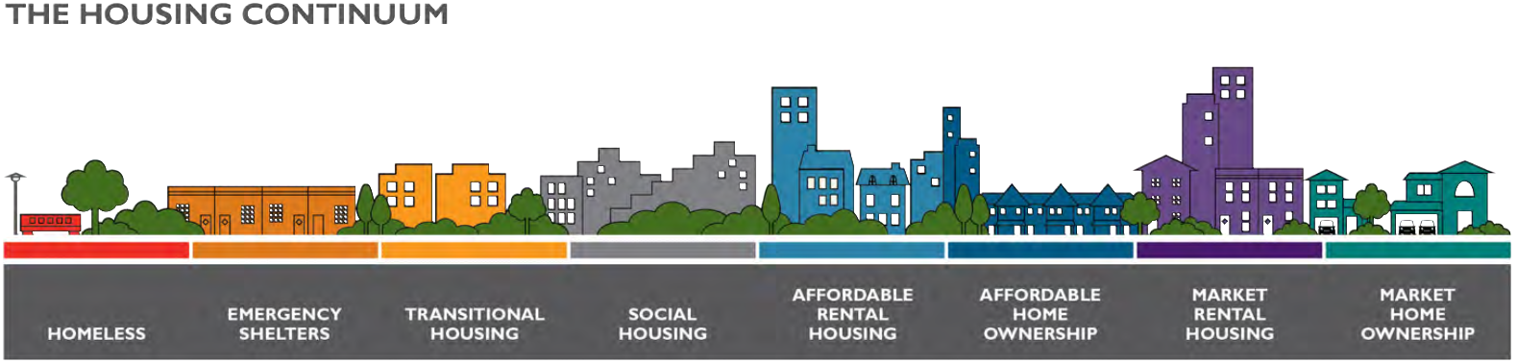
Housing Focus.
Low to moderate income households
Approx. $20,000 to $100,000
Source: Canadian Housing and Mortgage Corporation
Notes:
The Affordable Housing Accelerator Fund can make significant impact in accelerating projects that focus on the delivery of the missing middle housing – those with household incomes between approx. $20K and $100K. These are often the workers, professionals, teachers, nurses, and service works that live in our communities.
Government will and should continue to play a big part of housing delivery for those with core needs.

Slide 6

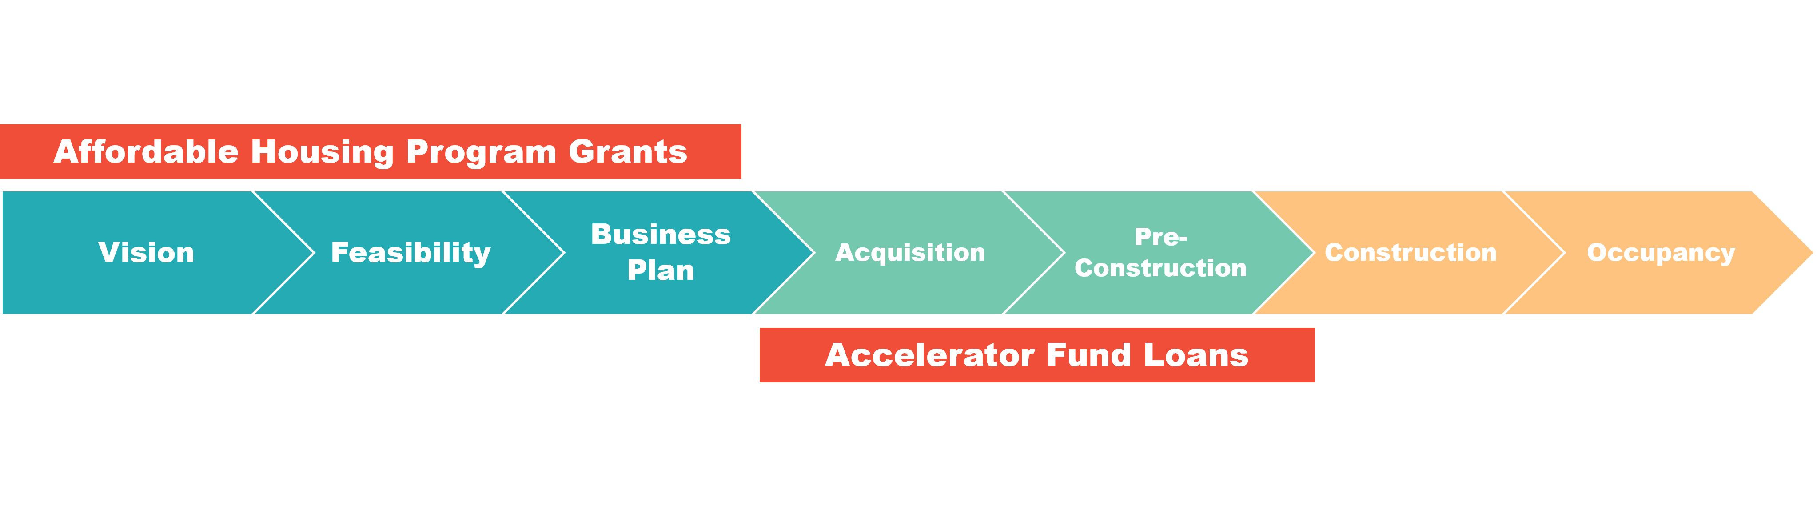
Program Tools.
1. Project Grants
  For the vision, feasibility, business planning phases of housing (re)development or acquisition affordable rental housing projects
2. Low-cost flexible loans
  To support expenses during the early phases of affordable housing development or acquisition when project risk is high, and timing is sensitive.
3. Capacity Building Grants
  To help organizations strengthen their ability to grow their affordable housing real-estate development goals.
Notes:
We provide essential early-stage funding to catalyze affordable housing rental projects – grants, low cost loans and capacity building grants.
The program was developed to address a key challenge faced by projects in the early phase (prior to construction) when project risk is high and funding/capital can be hard to find.
- For non-profit developers and operators of affordable housing, a lack of early nimble investment in the early phases restricts the speed and scale of housing development
Most investments from government and regular lenders are available at the start of construction or later.
To get to this stage of funding, community housing developers spend around 10 - 15% of total costs to advance design, close on land, and obtain necessary permits and approvals
By supporting the early stages of projects, we help fill a capital gap and help projects unlock access to other forms of funding and financing that often comes online later, such as construction and take-out financing from government and financial institutions.

Slide 7

Grant Products
Project Based Grants
Vision and Concept – up to $15,000
Feasibility Study – up to $30,000
Business Planning – up to $50,000
Capacity Building Grants
No minimum or max. We work 1:1 with organizations to determine their need.
Looking for big impact and potential to create more housing
Availability dependent on annual funding available

Slide 8
Loan Products
Pre-development loan
To support with soft costs associated with the rezoning, working drawings, and development permit processes etc. prior to construction.
  Repaid when construction financing secured, usually within 2-3 years
  2% simple interest rate
Pre-construction equity loan
Contributes to on-going pre-construction costs and project equity by remaining in the project up to ten years post occupancy.
  Typically repaid 5-7 years post occupancy with first refinancing
  2% simple interest rate
average loan size. $500,000
Acquisition loans
To support the acquisition of land or adjacent sites that increase units and financial viability of a project, including turn-key units or existing multi-unit residential buildings.
  Repayment upon securing mortgage and/or first refinancing
  Typically, 2-5% simple interest rate.
8
Notes:
Pre-development loan
Not-for-profit organizations may apply to receive a pre-development loan to help with soft costs associated with rezoning and development permit processes. The pre-development loan charges 2% simple interest and is usually repayable with the first draw of construction financing. This is typically within two years of receiving the loan. Funds may be advanced in a lump sum, or up to three separate amounts. The loan must be spent on real project costs outlined in the submitted project budget. Terms and conditions apply to the loans.
Pre-construction loan
Not-for-profit organizations may apply to receive a pre-construction loan to support the building permit process and development of working drawings to move towards construction. The long-term patient nature of these loans enables construction financing and other forms of investment from foundations, social impact investors etc. The pre-construction loan charges 2% simple interest, and is repayable with the first refinancing of a take-out mortgage. This is typically after five years of operations. Funds may be advanced in a lump sum, or up to three separate amounts. Terms and conditions apply to the loans.
Acquisition Loans
To support the purchase of turn-key affordable housing properties from for-profit developers

Slide 9
General Eligibility.
Not-for-profit, Co-operative, or First Nation Government or Indigenous organization.
You have site control of land (*unless an acquistion opportunity)
You have a credible project management team and capacity to initiative a housing project.
You are committed to affordability
You are committed to climate-resilient affordable housing
You prioritize social equity and accessibility
Your project is ideally located in Vancity’s operating areas - Metro Vancouver, the Fraser Valley, Southern Vancouver Island up to Nanaimo area, Squamish, and Alert Bay.
*Greater terms and conditions apply to the loans.
9
Notes:
You are a Not-for-profit, Co-operative, First Nation Government, or Indigenous organization
You have site Control of land, either through ownership or a long-term lease (*unless you are pursuing an acquisition loan)
You have a credible project management team with a demonstrated track record and the capacity to carry out the project.
You are committed to climate-resilient affordable housing and ideally your project will be pursuing step 3 of the BC energy code or greater (*may vary for an acquisition loan).
Your project demonstrates that it prioritizes social equity and accessibility
You are committed to affordability, at least 30% of the units must be less than 80% of the median market rent for the area and maintained for at least 20 years
*Greater terms and conditions apply to loans

Slide 10
Learn more.
  Contact us first to learn how to apply for grants and loans!
  We work with organizations 1:1 to get to know your project (and you!), build your application, and to determine alignment and eligibility.
  Funding is typically available March to November, but we respond to inquires year-round
  Up to 8-10 weeks to review formal requests, depending on funding availability and volume.
affordablehousing
@vancity
.com
10
Notes:
We may have you complete a project intake form.
If a fit is established, we typically request a basic proposal, scope of work, and budget (*or a viable business plan and pro-forma for loan requests). For capacity building grants, we typically also require a business plan.
We may require a memorandum of understanding to be developed between VCF and your organization for complex requests

Slide 11

Grant Results
2011 to 2022
185
grants
$3.15 million +
grants provided
97
vision, feasibility & business plans
    35 organizational capacity building grants
11
37% of homes can accommodate families (2 bedroom +)
Notes:
Impact:
Grants / Capacity
- 185 grants have been provided to 128 affordable housing initiatives, totaling over $3.15 Million.

Slide 12

Loan Results
2011 to 2022
83
loans
$31.7 million
loans approved
61
projects
50
not-for-profit partners
    91% homes will use at least 50% less energy relative to BC Building Code
4407
affordable rental homes supported
seniors
women and children
families
people with disabilities
Indigenous Peoples
12
37% of homes can accommodate families (2 bedroom +)
Notes:
Impact:
Over 50 community-based organizations have benefited from $31.7 million in loan financing in support of 63 affordable housing projects (2011-2022) to 38 loan recipients.
Accelerator loan fund financing is supporting the preservation and the development of 4407 homes.
Close to half, 46%, are now completed and another 17% are under construction. A significant share of the units is family-friendly (30%).
Almost half of all housing projects are creating housing for a specific demographic (in full or in part) such as youh, seniors, people with disabilities, refugees, women, families, people with intellectual disabilities, people in recovery.
Close to half, 47%, of the projects are mixed-use and include space for childcare, community services, meeting space, social enterprises, gallery, retail, non-profit office space, and more.
Thirty-four projects are currently in the loan portfolio. All of these projects are transit-friendly with an average distance to transit 131 metres. 91% of these homes will use at least 50% less energy relative to BC Building Code.

