Slide 1
THE WAY OUT:
Cowichan Vision for Wellness
2024

Slide 2
THE COWICHAN REGION
Success in the Cowichan region has been largely due to the way in which we work together, our regional focus to complex social issues.
Cowichan region local governments and Indigenous leaders are aligned across civic jurisdictions and mandates and united in their approach to clear and coherent goals.
Members of the Coalition to Address Homelessness have collaborated on a 3-phase comprehensive response to this complex crisis in our community.

Slide 3
Built on Partnerships and Working Together
Cowichan Neighbourhood House

Slide 4
Our Current Situation
A 2024 count by direct providers identified 423 People who are unhoused or residing in shelters, the Village or Sq’uamal in the central core.
The 2023 Point in Time report indicates that most of the 223 people reported that day are from our OWN region.
23% of those unhoused are from Lake Cowichan
46% of those unhoused are Indigenous and
Of that 46% - 17 were between the ages of 13 and 18

Slide 5
Our Current Situation - Shelter Options
Our limited shelter space includes:
36 beds at Warmland Shelter
24 beds at Cedar Branches Women’s Shelter
15 additional beds at Warmland during extreme cold weather
No current extreme weather shelter location identified
It is directly known that over 300 people require permanent housing
In 2023 444 people sheltered at Warmland. 80 of whom were over the age of 60 -the oldest guest was 77
Seniors Residential Care and Assisted Living are not able to support those living with mental health and addictions, complex care or health challenges

Slide 6
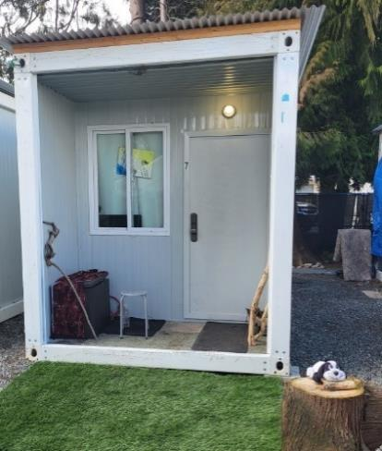
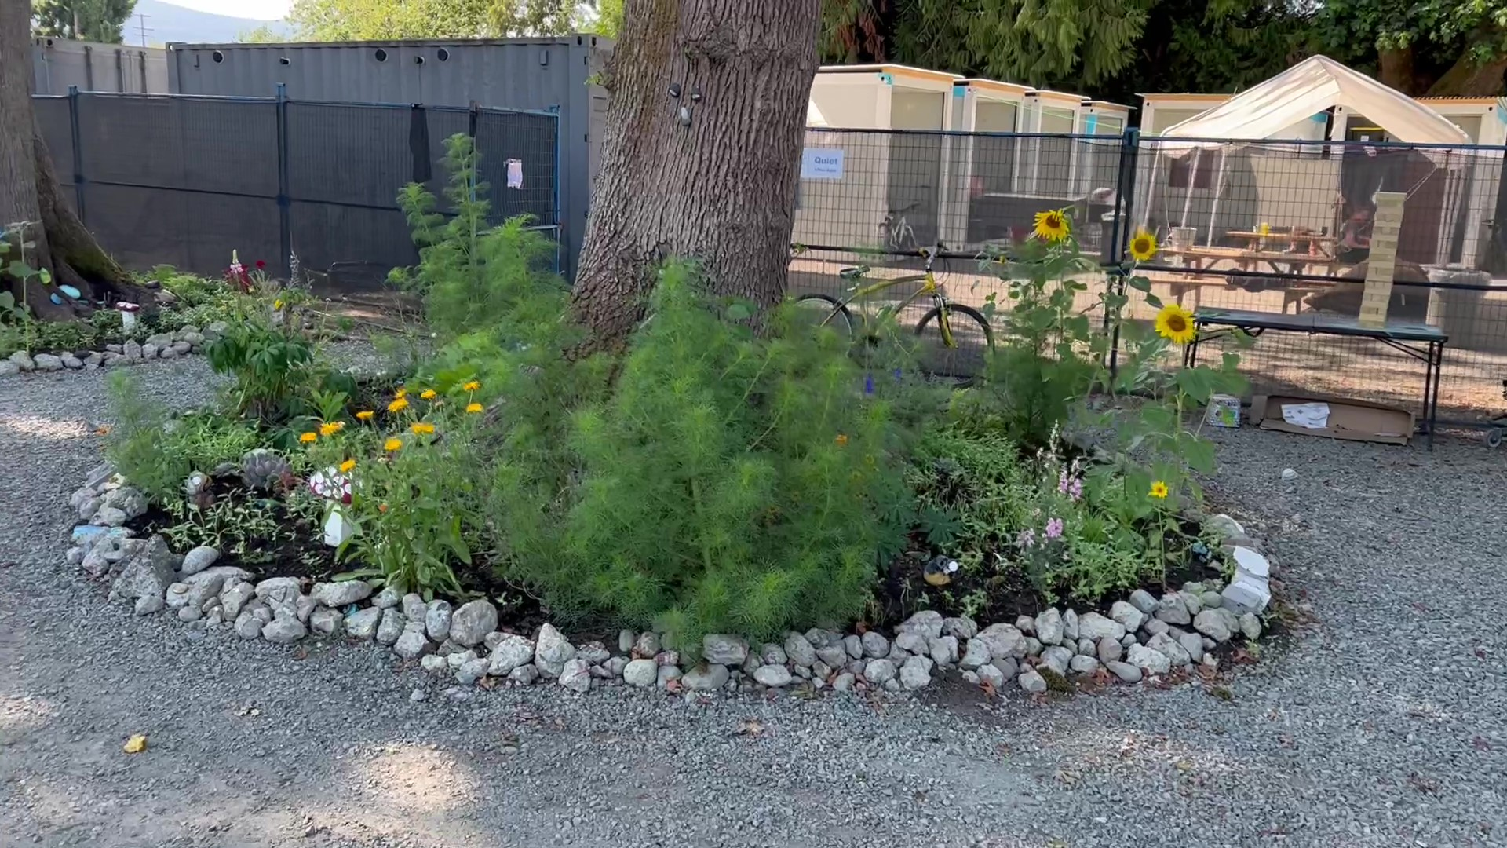
Our Current Situation - Supported Housing
Village 34 units
Squ’mul 52 Units
Warmland Bunk House and Apartments 24
2026/7 White Road 48 Units
Duncan Manor 122 Units for 55+ Seniors (Low Income and people with physical and mental health challenges), and Independent Living

Slide 7
OUR SOLUTION:
3 Phase comprehensive plan
Requires all levels of government to work collaboratively with investments in:
Land
Buildings/Infrastructure
Operations

Slide 8
Phase One 1-3 years
Immediate Priority - Complex Needs
Temporary
Supported Solutions
Shelter Space
Treatment
Acquisition or lease of 7x sites for Village-style projects across the region
Acquisition or lease of 2x sites for RV parking
$9 million
Acquisition or lease of site(s) for up to 30 additional shelter spaces with additional capacity as warming/cooling centres
$1 million
Acquisition of existing site for 20 treatment beds
Supportive recovery options
$2 million
Culturally grounded renovation of existing
space(s)
$500,000
Culturally grounded renovation of existing space
and purchase of 20 modular sleeping units
$1.5 million
Purchase of modular units and provision of site servicing
Supportive zoning
$6 million
Skilled employees to provide trauma informed, culturally grounded supports to those with the most complex needs
Site maintenance
$8 million annually
Skilled employees to offer trauma informed, culturally grounded supports to permanent shelter operations as well as increased capacity during extreme weather events
$1 million annually
Skilled employees to deliver trauma informed, culturally grounded treatment with pre-and post- treatment options
$2.6 million annually

Slide 9
Phase Two 2-4 years
Supports for Seniors
Outreach Supports
Income Supports
Purchase of 4 existing, multi-bed residences
$4 million
n/a
n/a
Renovations to each to ensure suitability and cultural safety within rooming house
$2 million
The infrastructure required - relationships with local non-profits with the capacity to administer resources
n/a
Investments in housing loss prevention measures:
Emergency/crisis supports
Rent subsidies
Guaranteed Basic Income
Enhance and expand mental health services, offering trauma informed, culturally grounded supports
Pre- and post- treatment supports
Peer Support options
Skilled employees to provide trauma informed, culturally sensitive daily supports
Site maintenance
$2 million annually

Slide 10
Phase Three 5-10 years
Permanent and Purpose-Built Options
Supported Housing
Second Stage Housing
Affordable Housing
Purchase of 2 development sites for supportive housing projects
$2 million
Purchase of development sites or existing buildings to offer transitional housing
Investments in affordable housing options in response to need identified in the Housing Needs Assessment -
for our workforce and low income families and seniors
Renovation of existing space
to meet specific needs of those leaving mental health or addictions treatment
Construction of 2 x 50-70 unit buildings
$20-24 million
Skilled employees to provide trauma informed, culturally grounded daily supports
Site and building maintenance
$2.8 million annually
Skilled employees to deliver trauma informed, culturally grounded treatment and daily supports
$1.6 million per site annually

Slide 11
YOUR SUPPORT
Local government can support this plan through:
*Endorsement
*Advocacy - at provincial and federal levels
*Contribution - land/infrastructure,
- supportive zoning and bylaws

Slide 12
When Properly Resourced… There is Hope – We Know What Works
The Village- Changing lives – Changing Community
1 in 5 accessed treatment with other substance use significantly reduced
Crime down 18% in neighbourhood Q2 2023
88% engaged in peer work and employment caring for neighbourhood and providing outreach which contributes to a safer community for all
Costs to service providers significantly reduced including 75 % reduction in emergency department visits
Precursor to treatment and recovery. "Now I am supported. Now I am ready."

Slide 13
FROM THIS - TO THIS
Photo above- Cowichan Valley Citizen

Slide 14
Huy ch q’u
Thank you

